Slide 1
WHETHER ANALYSIS
BY
ASWINI.M

Slide 2
Agenda
Introduction
Objective
Code implementation
Module used
Output
Future scope

Slide 3
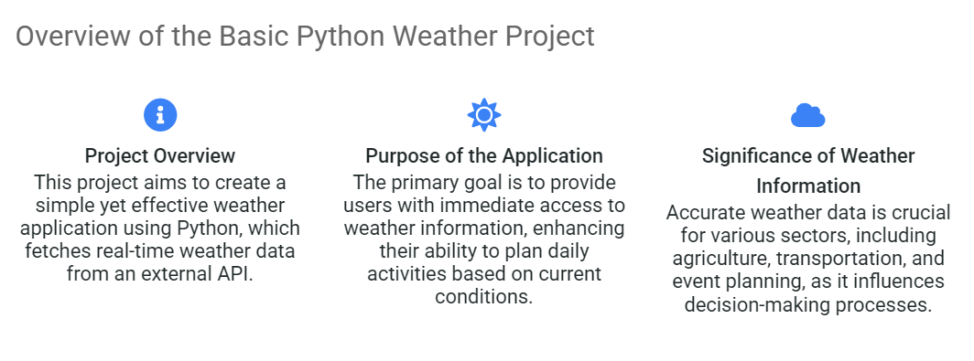
Introduction

Slide 4
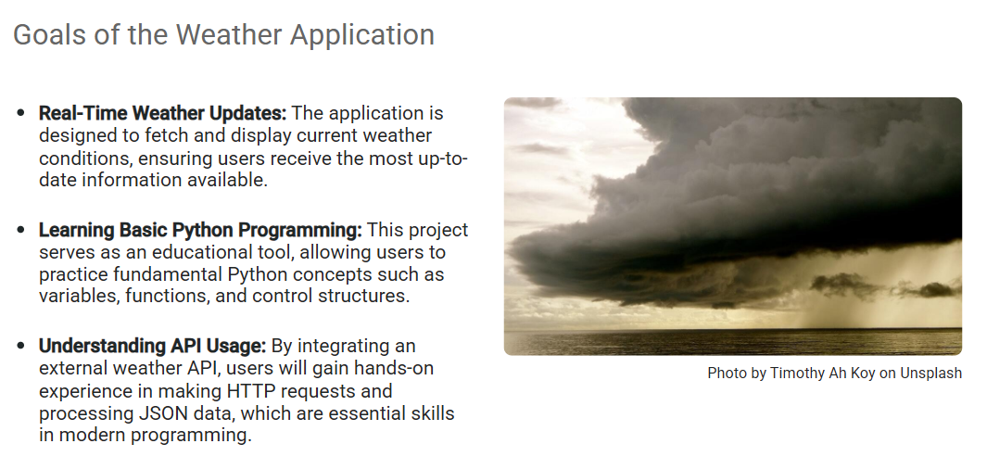
Objective

Slide 5
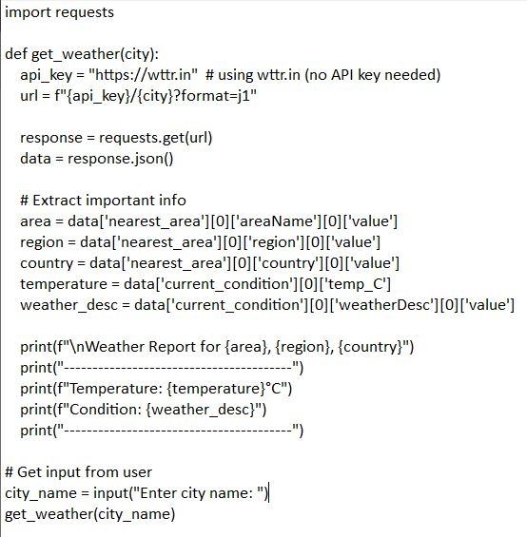

Code implementation

Slide 6
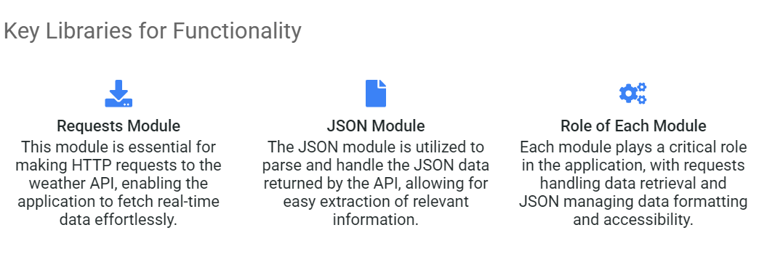
Modules used

Slide 7
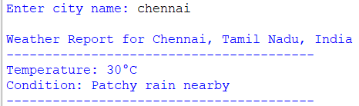
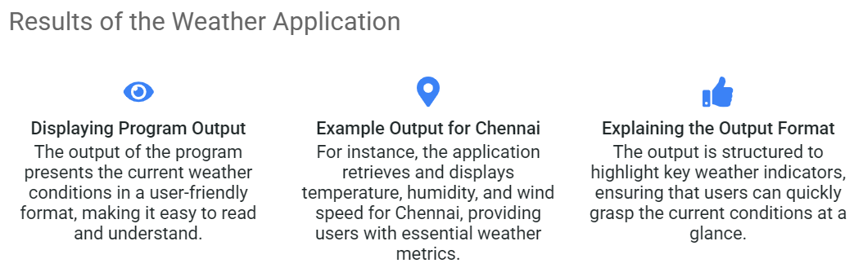
Output

Slide 8
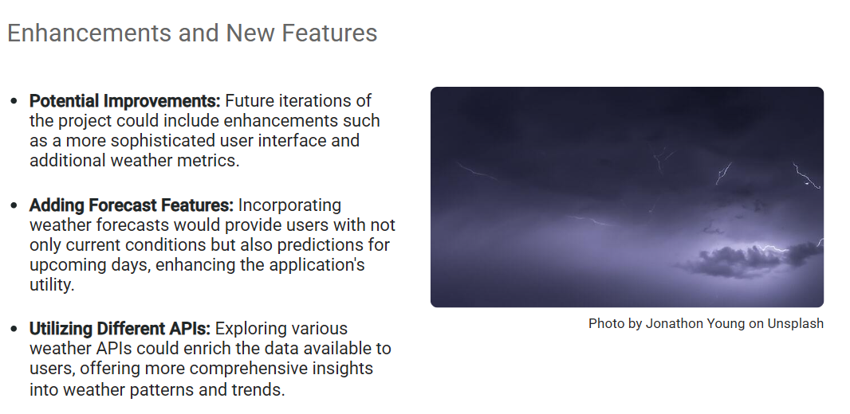
Future scope

